Slide 1
JS for Beginners
Class - 3

Slide 2
Class Objective
Previous Lessons Review
Functions
Classes
Object/Arrays
Software Installation
Introduction
How to use
Intro to NodeJS
Introduction
Express
Project Setup
Building CRUD App

Slide 3
Review Session
Functions
Exercise:
Write a function that converts normal sentence into all uppercase sentence
Eg: I love to code => I LOVE TO CODE
Class
Exercise:
Define a class with function called showTodayDate() which gives today date and time in YYYY-MM-DD HH:mm format when called.
Eg: Todays Date: 2020-02-30 10:00

Slide 4
Exercise
Object/Array
Exercise:
Define an Object called book
Book should have name, pages, and author as property
Add that book Object into Array
Add other two more books into the array
Eg: [{book1},{book2},{book3}]

Slide 5
Software installation
NodeJS
Yarn
MongoDB
MonogDB Compass
POSTMAN

Slide 6
Software Installation Testing
Goto Command Prompt or Git Bash and
Type the following command to execute the command
node –v
npm –v
yarn –v
mongo

Slide 7
Introduction to NodeJS
Free open source server environment
uses JavaScript on the server
Node.js files have extension ".js"
asynchronous programming!
allows multiple things to happen at the same time
Uses
Node.js can generate dynamic page content
Node.js can create, open, read, write, delete, and close files on the server
Node.js can collect form data
Node.js can add, delete, modify data in your database

Slide 8
Express (Web Application Framework)
minimalist web framework for Node.js
Why do we use it?
For scalable web applications
For REST API (to create a routine which enable software to talk to itself or to other)
For Performance/Standard coding structure

Slide 9
Getting Started
Instructions (Basic Express Setup)
npm install -g express-generator
express --view=pug/ejs myapp
Myapp refers to project folder that you will be creating
Pug/ejs refers to the view templating
Exploring the Express Project

Slide 10
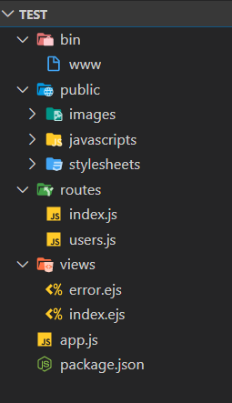
Project Structure
Bin folder represent nodeJS Server
Public folder holds assets
Routes hold the navigation in sites
Views hold the page content/data representation
App.js holds our web application configuration
Package.json holds dependencies used in our application

Slide 11
Basic Routing
Methods
GET
list
POST
add/create
PUT/PATCH
update the existing data
DELETE
deleting the existing data

Slide 12
BUILDING CRUD APPLICATION PART 1
Github Link: https://github.com/rakimsth/book_mgmt_system

Slide 13
Steps
Generate the express framework using express-generator
Add configuration specific to the project (config folder aka env files)
Add your necessary dependencies (package.json)
Connect database to the project(app.json)
Rearrange the file structure(routes …)
Add Modules(based on your application)
CRUD Operations
Add Views(UI Files)

Slide 14
Q & A

Slide 15
Assignments
CREATE YOUR OWN ANY KIND OF
CRUD APPLICATION

